Slide 1
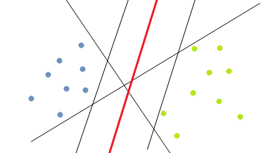
Support Vector Machines
MODULE – 8

Slide 2
Support Vector Classifiers

Slide 3
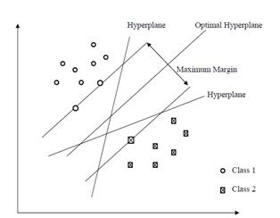
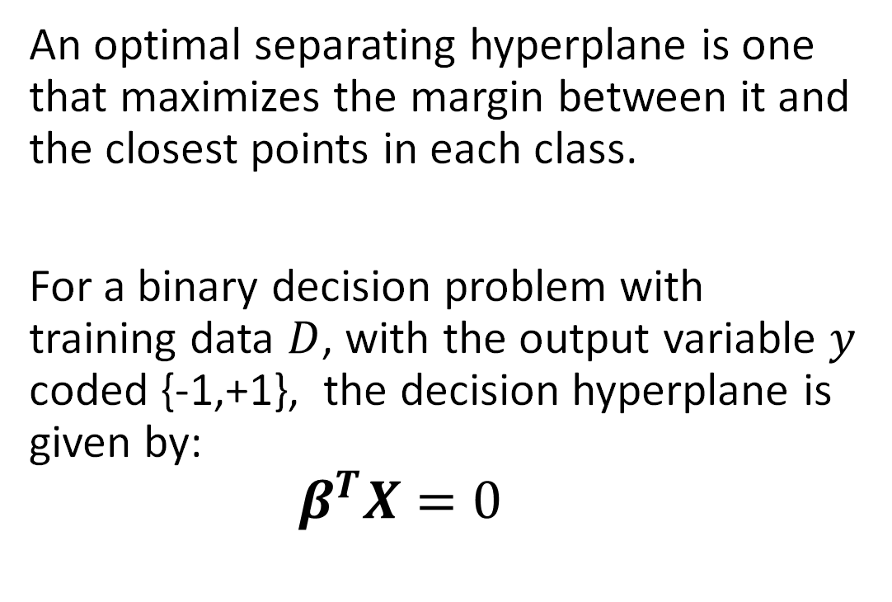
Optimal Separating Hyperplane
An optimal separating hyperplane is one that maximizes the margin between it and the closest points in each class.
For a binary decision problem with training data $D$, with the output variable $y$ coded {-1,+1}, the decision hyperplane is given by:
$$β^{T}X=0$$

Slide 4

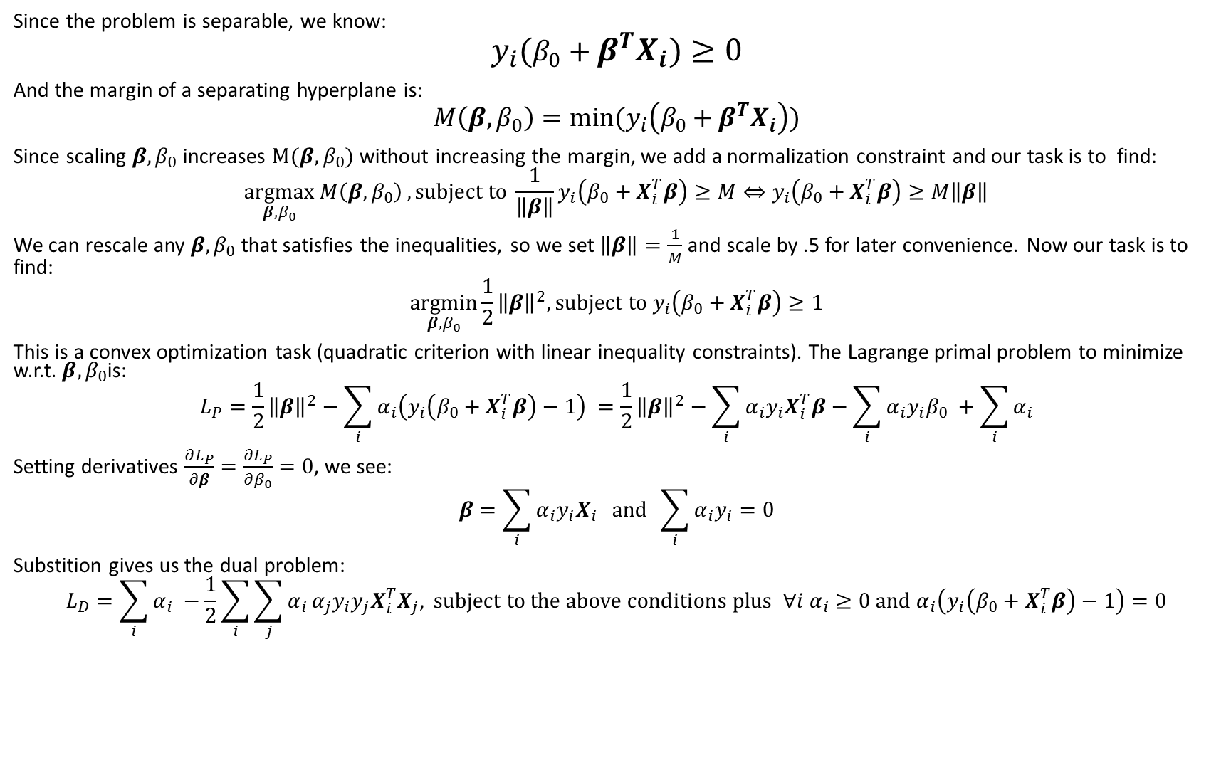
Calculating an Optimal Hyperplane (Separable Case)
Since the problem is separable, we know:
$$y_{i}(β_{0}+β^{T}X_{i})≥0$$
And the margin of a separating hyperplane is:
$$M\left(β,β_{0}\right)=min⁡(y_{i}\left({β_{0}+β}^{T}X_{i}\right))$$
Since scaling $β,β_{0}$ increases $M(β,β_{0})$ without increasing the margin, we add a normalization constraint and our task is to find:
$$\underset{β,β_{0}}{argmax}{M\left(β,β_{0}\right)}, subject to \frac{1}{\left\|β\right\|}y_{i}\left(β_{0}+X_{i}^{T}β\right)≥M⇔y_{i}\left(β_{0}+X_{i}^{T}β\right)≥M\left\|β\right\|$$
We can rescale any $β,β_{0}$ that satisfies the inequalities, so we set $\left\|β\right\|=\frac{1}{M}$ and scale by .5 for later convenience. Now our task is to find:
$$\underset{β,β_{0}}{argmin}{\frac{1}{2}}{\left\|β\right\|}^{2}, subject to y_{i}\left(β_{0}+X_{i}^{T}β\right)≥1$$
This is a convex optimization task (quadratic criterion with linear inequality constraints). The Lagrange primal problem to minimize w.r.t. $β,β_{0}$is:
$$L_{P}=\frac{1}{2}{\left\|β\right\|}^{2}−\sum_{i}{α_{i}\left(y_{i}\left(β_{0}+X_{i}^{T}β\right)−1\right) }=\frac{1}{2}{\left\|β\right\|}^{2}−\sum_{i}{α_{i}y_{i}X_{i}^{T}β}−\sum_{i}{α_{i}y_{i}β_{0} }+\sum_{i}{α_{i}}$$
Setting derivatives $\frac{∂L_{P}}{∂β}=\frac{∂L_{P}}{∂β_{0}}=0$, we see:
$$β=\sum_{i}{α_{i}y_{i}X_{i}} and \sum_{i}{α_{i}y_{i}}=0$$
Substition gives us the dual problem:
$$L_{D}=\sum_{i}{α_{i} }−\frac{1}{2}\sum_{i}{\sum_{j}{α_{i}}α_{j}y_{i}y_{j}X_{i}^{T}X_{j},} subject to the above conditions plus ∀i α_{i}≥0 and α_{i}\left(y_{i}\left(β_{0}+X_{i}^{T}β\right)−1\right)=0$$

Slide 5
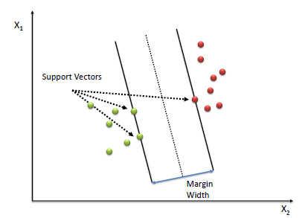
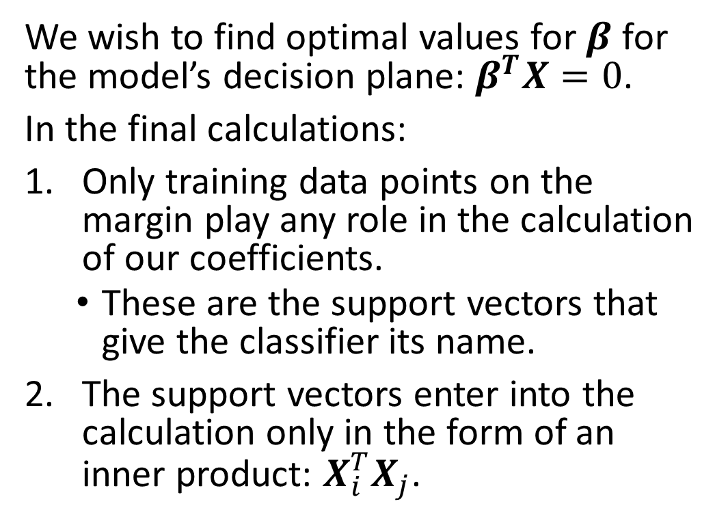
Calculating an Optimal Hyperplane (Separable Case) What you should know…
We wish to find optimal values for $β$ for the model’s decision plane: $β^{T}X=0$.
In the final calculations:
Only training data points on the margin play any role in the calculation of our coefficients.
These are the support vectors that give the classifier its name.
The support vectors enter into the calculation only in the form of an inner product: $X_{i}^{T}X_{j}$.

Slide 6
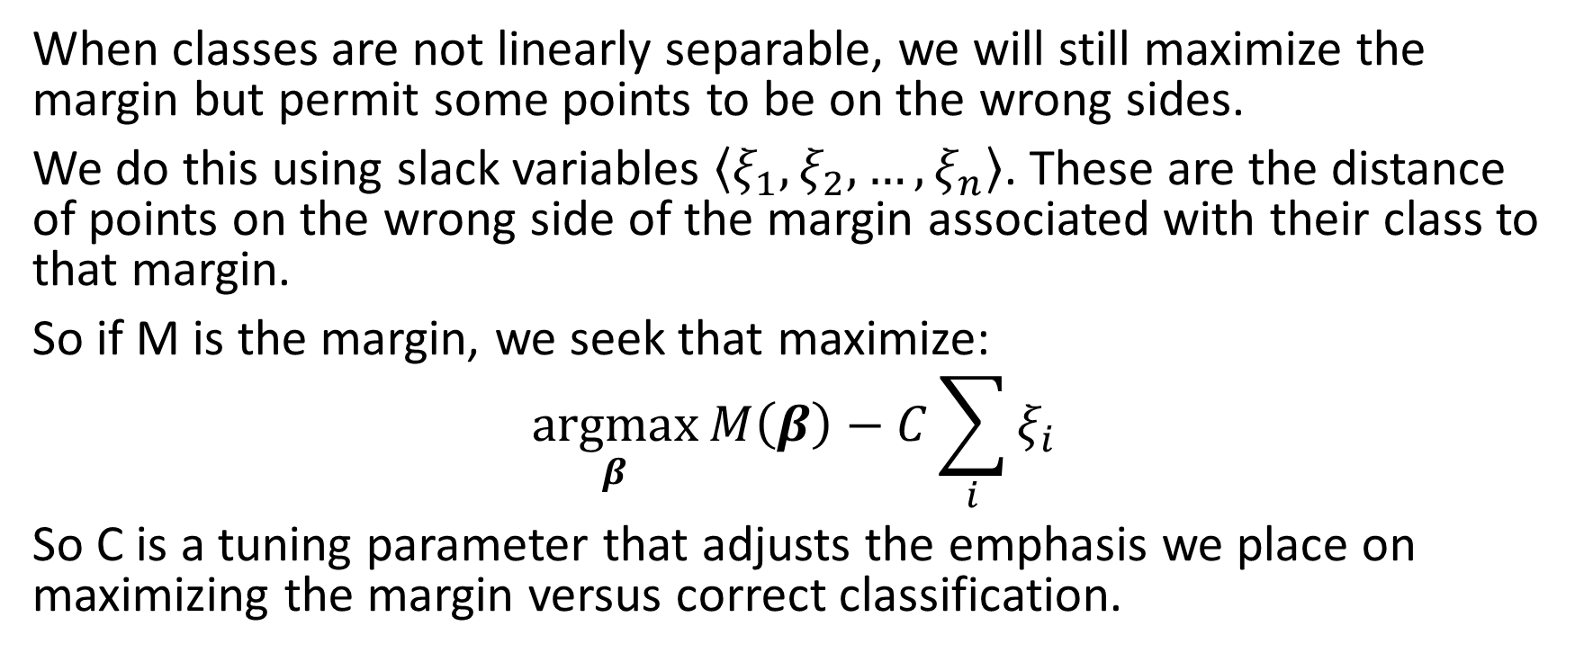
Calculating an Optimal Hyperplane (Inseparable Case)
When classes are not linearly separable, we will still maximize the margin but permit some points to be on the wrong sides.
We do this using slack variables $\left\langle ξ_{1},ξ_{2},…,ξ_{n}\right\rangle$. These are the distance of points on the wrong side of the margin associated with their class to that margin.
So if M is the margin, we seek that maximize:
$$\underset{β}{argmax}{M\left(β\right)−C\sum_{i}{ξ_{i}}}$$
So C is a tuning parameter that adjusts the emphasis we place on maximizing the margin versus correct classification.

Slide 7
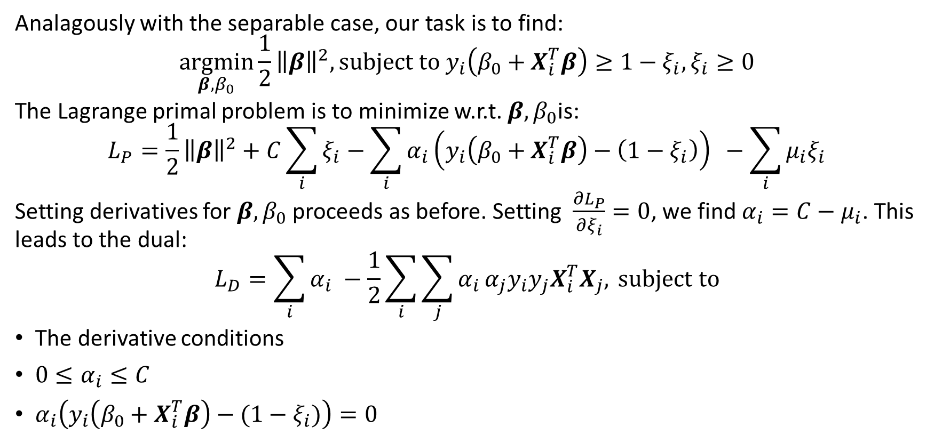
Calculating an Optimal Hyperplane (Inseparable Case)
Analagously with the separable case, our task is to find:
$$\underset{β,β_{0}}{argmin}{\frac{1}{2}}{\left\|β\right\|}^{2}, subject to y_{i}\left(β_{0}+X_{i}^{T}β\right)≥1−ξ_{i},ξ_{i}≥0$$
The Lagrange primal problem is to minimize w.r.t. $β,β_{0}$is:
$$L_{P}=\frac{1}{2}{\left\|β\right\|}^{2}+C\sum_{i}{ξ_{i}}−\sum_{i}{α_{i}\left(y_{i}\left(β_{0}+X_{i}^{T}β\right)−\left(1−ξ_{i}\right)\right) }−\sum_{i}{μ_{i}ξ_{i}}$$
Setting derivatives for $β,β_{0}$ proceeds as before. Setting $\frac{∂L_{P}}{∂ξ_{i}}=0$, we find $α_{i}=C−μ_{i}$. This leads to the dual:
$$L_{D}=\sum_{i}{α_{i} }−\frac{1}{2}\sum_{i}{\sum_{j}{α_{i}}α_{j}y_{i}y_{j}X_{i}^{T}X_{j},} subject to$$
The derivative conditions
$0≤α_{i}≤C$
$α_{i}\left(y_{i}\left(β_{0}+X_{i}^{T}β\right)−(1−ξ_{i})\right)=0$

Slide 8
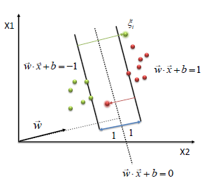
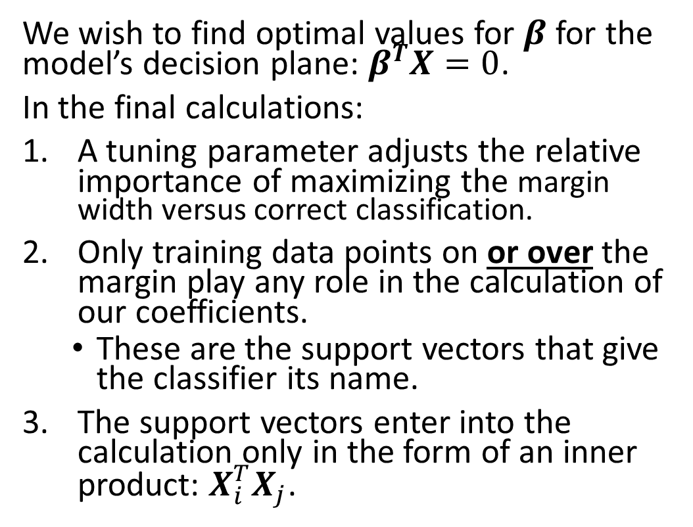
Calculating an Optimal Hyperplane (Inseparable Case) What you should know…
We wish to find optimal values for $β$ for the model’s decision plane: $β^{T}X=0$.
In the final calculations:
A tuning parameter adjusts the relative importance of maximizing the margin width versus correct classification.
Only training data points on or over the margin play any role in the calculation of our coefficients.
These are the support vectors that give the classifier its name.
The support vectors enter into the calculation only in the form of an inner product: $X_{i}^{T}X_{j}$.
Support Vectors

Slide 9
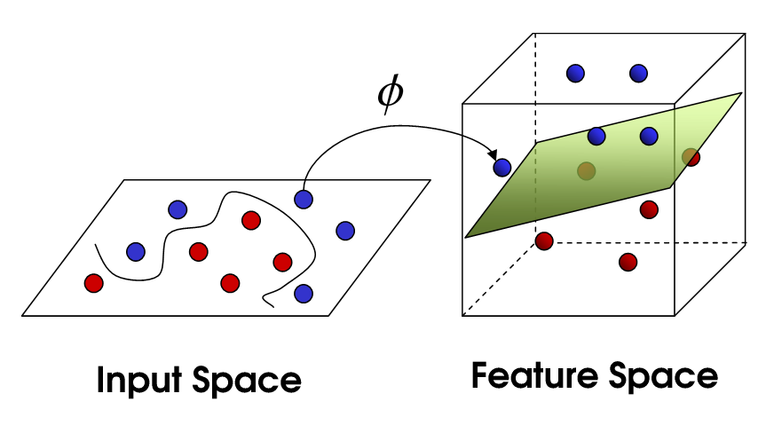
Support Vector Machines

Slide 10

Cover’s Separability Theorem
A complex pattern-classification problem, cast in a high-dimensional space non-linearly, is more likely to be linearly separable than in a low-dimensional space, provided that the space is not densely populated.
So, lets project our input space into a higher dimension and then apply the SVC in this new space.
After all - we've seen this idea works for many techniques.

Slide 11
The Kernel Trick
L_{D} = ∑_{i}α_{i} – ½∑_{i}∑_{j}α_{i}α_{j}y_{i}y_{j}x_{i}^{T}x_{j}
We saw that individual input vectors are involved in our calculations only as inner products.
When we project into a higher dimensional space using the mapping h(x) we have:
L_{D} = ∑_{i}α_{i} – ½∑_{i}∑_{j}α_{i}α_{j}y_{i}y_{j}h(x_{i})^{T}h(x_{j})
Again – the transformed vectors are involved only as inner products.

Slide 12
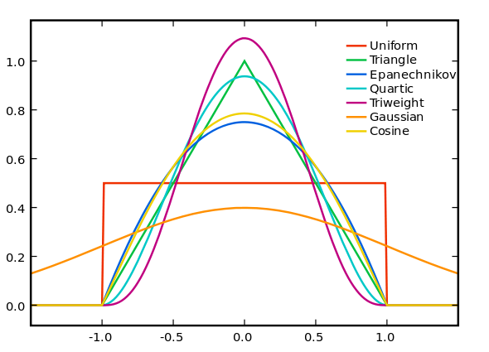
Kernels: Revision
We remember that a function k(x₀,x) is a kernel if it:
Takes a maximal value at x₀.
Is symmetric around x₀.
Is a continuous, bounded real function of x.
Integrates to unity.

Slide 13
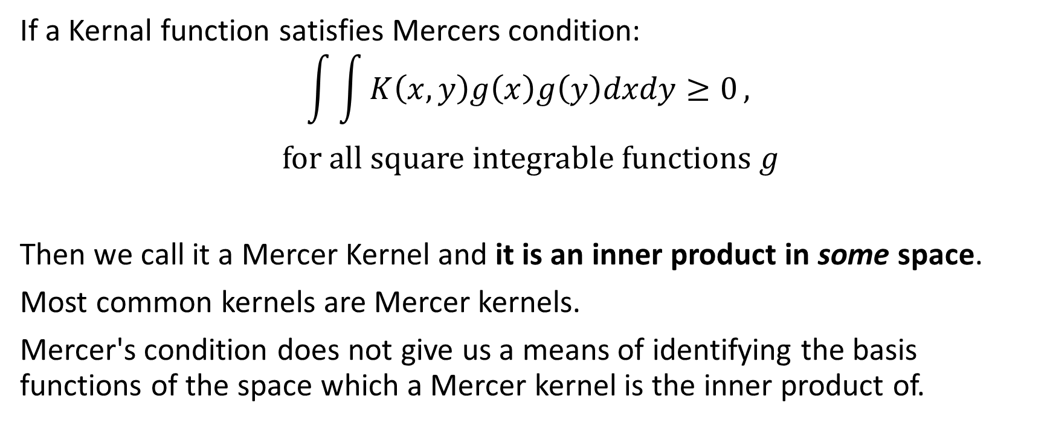
Mercer’s Theorem
If a Kernal function satisfies Mercers condition:
$$\int{\int{K\left(x,y\right)g\left(x\right)g\left(y\right)dxdy≥0}},$$
$$for all square integrable functions g$$
Then we call it a Mercer Kernel and it is an inner product in some space.
Most common kernels are Mercer kernels.
Mercer's condition does not give us a means of identifying the basis functions of the space which a Mercer kernel is the inner product of.

Slide 14
The Kernel Trick
L_{D} = ∑_{i}α_{i} – ½∑_{i}∑_{j}α_{i}α_{j}y_{i}y_{j}h(x_{i})^{T}h(x_{j})
As the transformed training data h(x) enter into L_{D} only as an inner product and our kernels provide us an inner product on some higher dimensional space, we can use these kernels to project into such a space without having to actually perform any explicit basis transformation.
L_{D} = ∑_{i}α_{i} – ½∑_{i}∑_{j}α_{i}α_{j}y_{i}y_{j}k(x_{i},x_{j})

Slide 15
Compare Kernel Use:
Classifier | Kernel Density Estimation | Naive Thin Plate Splines | K-Mediods Thin Plate Splines | SVM
RBFs/Kernels Placed On | All training points. | All training points. | Mediods of the k clusters. | The support vectors.

Slide 16
Support Vector Machines What you should know
Use only a (generally small) subset of the training points in generating the model: The support vectors.
Selects those training points used such that we expect them to be specially useful in establishing the decision boundary. (They are on or over the margin.)
Uses the kernel trick to perform an implicit projection into a higher dimensional feature space.
Uses a tuning parameter to adjust the relative importance of maximizing the margin width versus correct classification.
The more important the margin maximization is, the more support vectors there are.

Slide 17
Support Vector Machines Exercises
Use package e1071 and the titanic data set.
Split your data into training, validation and test sets.
Make svm models using all 4 types of kernel, with a range of kernel parameters and a range of cost values. (Do about 20.) Make sure to also use the class-weight parameter to make up for unequal class sizes.
Select the best model on the validation data.
Examine its performance on test data.

Slide 18
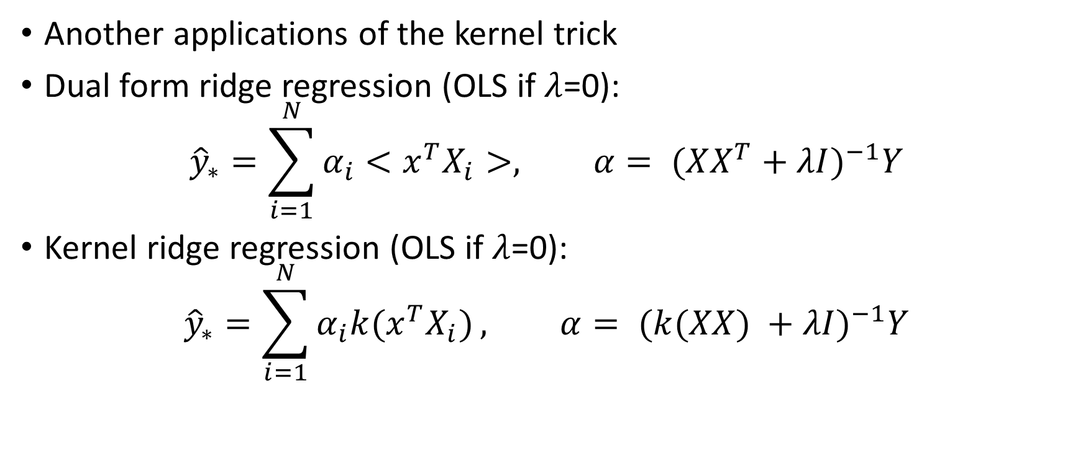
Kernel Regression
Another applications of the kernel trick
Dual form ridge regression (OLS if $λ$=0):
$${\hat{y}}_{∗}=\sum_{i=1}^{N}{α_{i}<x^{T}X_{i}}>, α= {(XX^{T}+λI)}^{−1}Y$$
Kernel ridge regression (OLS if $λ$=0):
$${\hat{y}}_{∗}=\sum_{i=1}^{N}{α_{i}k{(x}^{T}X_{i})}, α= {(k(XX) +λI)}^{−1}Y$$

